Slide 1


No Fault Found (day 1):
Diagnostics & Testing
Dr Samir Khan

Slide 2

Overview
Basics of NFF
Cost Impact of NFF
Environmental Causes of NFF
Intermittent Faults
Intermittent Fault Testing

Slide 3
What is Meant by No Fault Found?
What is meant by No Fault Found?
“A reported fault for which the root cause cannot be determined” – Diagnostic failure
“A reported fault for which there never was a root cause -> Reporting Failure?”
“A reported fault which results in nugatory maintenance and logistic effort -> a simple waste of time and effort!

Slide 4
What is Meant by No Fault Found?
Firstly, we should consider the main scenarios resulting NFF:
A simple reset clears the fault and the unit is certified as serviceable
No evidence of faults during functional testing so the unit can be certified as serviceable as there probably never was a fault.
Functional testing hints at a fault but is inconclusive. The system is then sent for further testing further down the maintenance chain
Consequences?
Reduced availability and/or safety
Pressure on spare parts and logistics
Wasteful maintenance
Increased costs through applying the “quick fix” rather than the “right fix”
The original fault will almost certainly return! – Repeat Arising

Slide 5
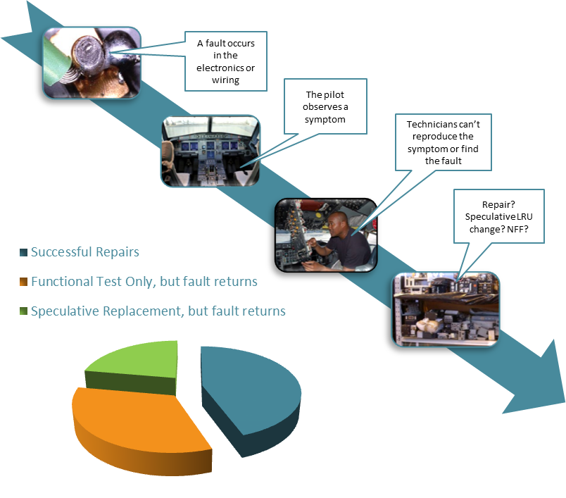
Notes:
What we find is that many of the NFF events are attributed to on-spec replacements, where the wrong unit has been removed and the fault re-occurs on-board the vehicle. However, even more cases are attributed to the failure in functional testing to replicate the fault.

Slide 6
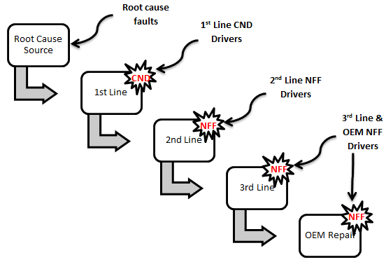
Root Cause
Actual fault
False Alarm
NFF Drivers
Test equipment
BIT/BITE
Intermittency
Inadequate troubleshooting
Operational pressure
Availability requirements
Culture
No Fault Found - NFF is not a single event but a series of events and mix of influencing factors which result in a failure to diagnose the problem
The problem – something has occurred which has called for action, be that a fault, a false alarm or a misdiagnosis the root cause for the removal has to be identified to avoid NFF!

Slide 7
Example Highlighting Diagnostic Failure Leading to repeat Arisings
Date | Fleet | A/C | Base | ATA | Fault | Action
2/1/12 | Q400 | G-ECOA | BHX | 31 | Aborted takeoff due to “take off config warning” – note all levers/switches in the correct position, System test 4 times and failed | A/c ground run & put into T/off config, no warnings apparent, test carried out 3 times, system found serviceable.
17/1/12 | Q400 | G-ECOA | MAN | 31 | T/O config warning, all relevant things checked as in correct positions, poss failure in parking brake switch | Park brake control cable rigged iaw amm 32-44-26-830-803. Functional test of T/O warning system c/out iaw amm 31.51-00-720-801 ‘satisfactory’
24/4/12 | Q400 | G-ECOA | AMS | 31 | T/O warning horn as power levers advanced to t/o | Functional check of take off config warning system, carried out iaw amm 31.51-00-720-801. All indications normal
20/5/12 | Q400 | G-ECOA | JER | 31 | After pushback t/o config test failed | Full take off warning system functional check c/out iaw amm 31-52-00-720-801. All functions and warning normal
29/5/12 | Q400 | G-ECOA | MAN | 31 | Spurious take off config | CDS, interrogated no codes for any IOP/IOM failure. PESU interrogated, nose WOW satisfactory with no faults ………… replacement of park brake module ……….
17/6/12 | Q400 | G-ECOA | MAN | 31 | RTS Take off config warning | Both IOMs replaced

Slide 8
Why do Repeat Arising's Occur?
The same functional tests/procedures carried out time and time again with same NFF result
Maintenance engineers do not have access to other bases maintenance records?
Do maintenance engineers have the time to look through the records?
Obviously follow the necessary procedures – if the functional tests return ‘satisfactory’ – do they care what occurred weeks previous?
Will speculatively replace components – pressure and the to convince the pilots that proactive actions have been taken to rectify the fault!
Aircraft is out of the hanger and serviceable to fly before the end of the shift – JOB DONE!

Slide 9
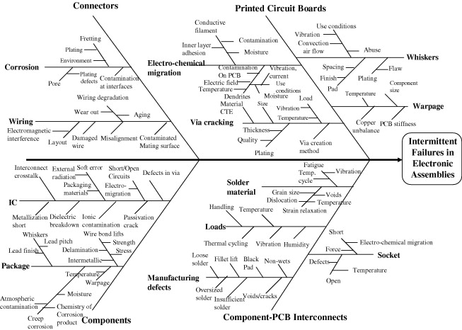
Failures in Electronic Assemblies

Slide 10
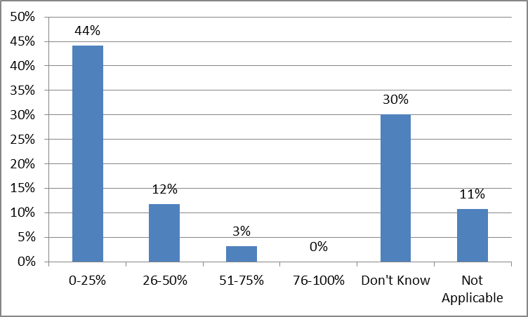
Component Repairs
Question
“How many component repairs result in NFF?”

Slide 11
What is the financial impact?
Senior decision makers need to be able to acknowledge the impacts of NFF within complex technical systems, including safety, availability and increased lifecycle costs
Expensive downtime means less time for troubleshooting
Where are the costs met?
All maintenance lines
Lost revenue (availability of equipment)
Logistics (transportation costs)
Spare parts chain
How can we measure these costs?
Maintenance hours
Industry charges
Cost of replacement parts
Warranty claims
No formal method has been identified to assess the financial impact of NFF
£
Time + Effort =

Slide 12
Overview
Basics of NFF
Cost Impact of NFF
Environmental Causes of NFF
Intermittent Faults
Intermittent Fault Testing

Slide 13
Example of the Cost within the RAF Utilising Maintenance Man Hours
Example Data for the Harrier Fleet (Fl Sgt Stewart Roke 2010)
FSC | DESCRIPTION | MMH | Estimated Cost (£55/hour)
4100 | Power Plant | 2773.05 | £153K
8010 | Armament Systems General – Stores Management | 2521.52 | £138K
4150 | Fuel System - Indication | 1621.41 | £89K
7410 | Automatic Flight Control - SAAHS | 1337.07 | £73K
7620 | Communication, Navigation & Identification - Communications | 1320.38 | £73K
7310 | Navigation & Flight Aids Systems – Inertial Navigation Unit | 1298.25 | £71K
6210 | Electronic Warfare – ECM / RWR | 964.89 | £53K
7110 | Data Processing – Mission Computer | 766.94 | £42K
4150 Fuel System Indication the NFF MMH was 22% of all MMH carried out (over 3 years)
7410 Automatic Flight Control the NFF MMH was 18% of all MMH carried out

Slide 14
Overview
Basics of NFF
Cost Impact of NFF
Environmental Causes of NFF
Intermittent Faults
Intermittent Fault Testing

Slide 15
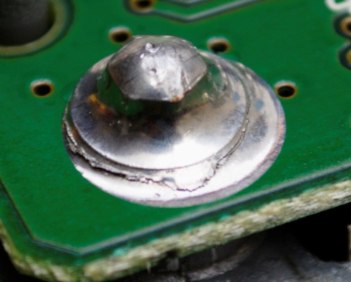
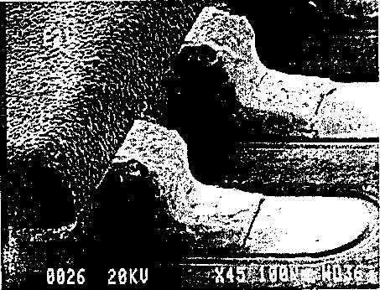
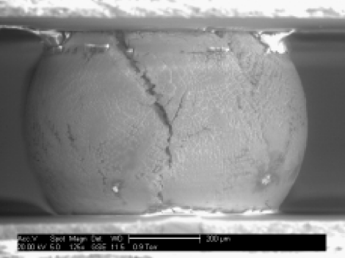
Component PCB Interconnects – Environmental Loading
Handling
Temperature/humidity
Vibration
Thermal Cycling
Shock Loads
Thermal cycling fatigue
Cracked Solder
Notes:
Loads as a fault cause

Slide 16
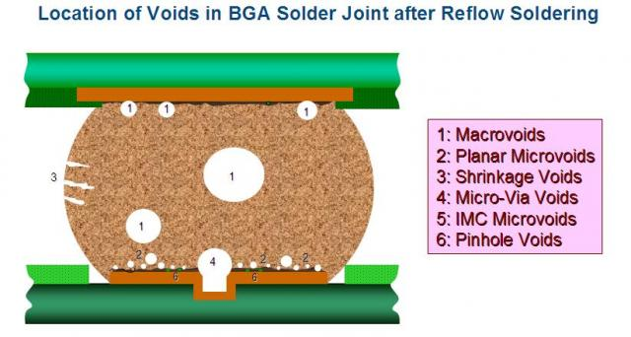
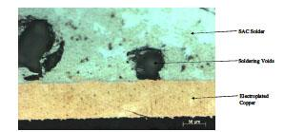
Solder Material Defects
Voids generated by the evolution of volatile ingredients of fluxes and solder pastes
Found anywhere in the solder joint
PCB and Component
surface Finish
Oxide content of soldered surface
Contamination
Solder Paste
Solvent …Amount, Boiling Point, Volatility
Solder Powder characteristics
Flux ….activity, amount
Notes:
Can be micro or macro

Slide 17
Lead Free Solder
Lead based solder is restricted to military (legislation)
Reliability concerns
Fatigue crack characteristics, and solder fatigue propagation mechanisms are more common to lead-free alloys
Features such as stress voids, crack path redirection around intermetallic formations, vertical cracking and spalling

Slide 18
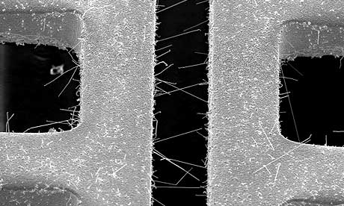
Tin Whiskers
Tin finish is well known to produce conductive ‘metal whiskers’ capable of producing unintended current paths leading to faults
Whiskers are a result of chemical reaction and can grow very rapidly.
Failures relating to metal whiskers are usually intermittent shorts
Can create a leakage current under a ‘powered-up condition’ or change in potential
Become electrically open under a ‘powered down condition’

Slide 19
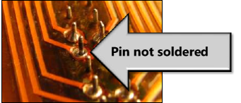
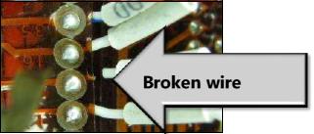
PCB Interconnects – Manufacturing Defects
Missed or poor solder points
Inadequate production testing
Loose connections
Unconnected wires
Handling, storage and transportation loads
Notes:
Lead free solder

Slide 20
Connectors
Wiring
Ageing
Contamination
Installation
Structural interactions
Electromagnetic interference
Corrosion
Fretting
Contamination
Plating defects
Enviroment

Slide 21
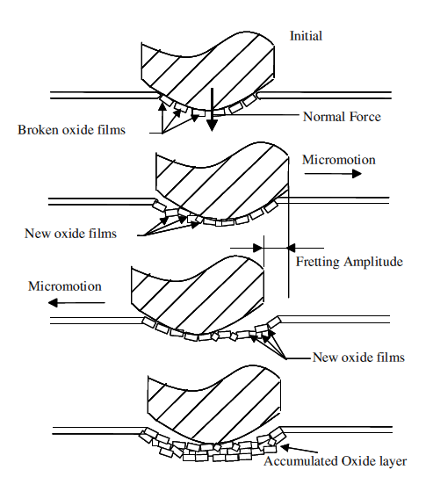
Connectors - Fretting Corrosion
Oxidisation of the metal-metal interface
Caused by the presence of humidity
Oxides at the contact increase resistance & electrical intermittency
Typically present in tin plated contacts

Slide 22
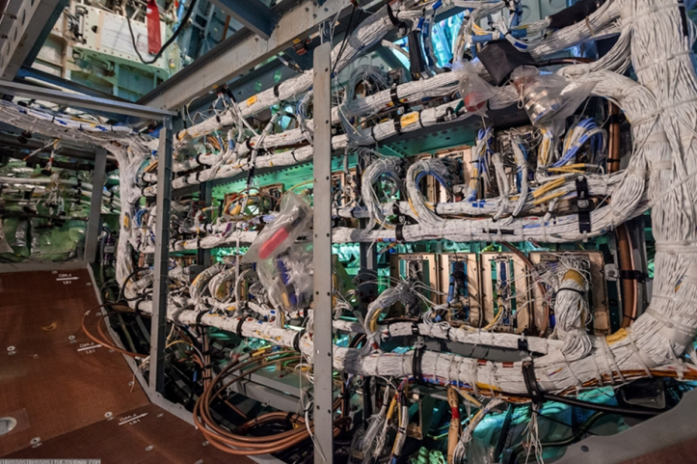
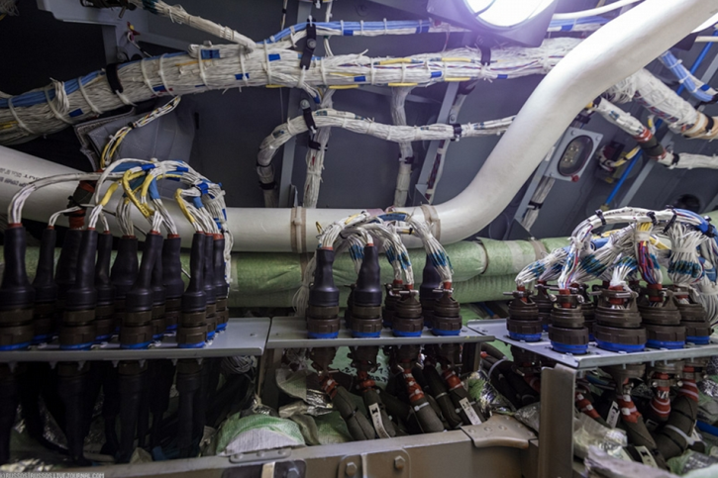
Degradation in Wiring
Complex electronic based platforms contain significant amounts of wiring
Susceptible to ‘chaffing’ damage through interactions with structures
Excessive vibration causing wire flexing results in wire breaks
Breakdown of electrical & thermal insulation due to temp/humidity/contaminates
Wiring faults are notoriously difficult to detect and are a leading cause of wrongly removed items.

Slide 23
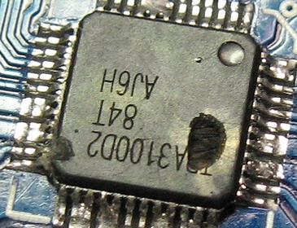
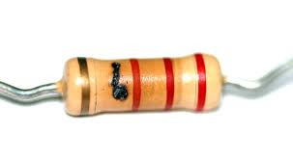
Components Degradation
Many of the failures modes in electronic components (such as IC’s) are as a result of mechanical ageing
Specific mechanisms that occur with aging are not quite intuitive fully understood or considered in the design process.
IC damage
Resistor damage

Slide 24
Detection & Inspection of Electronic Degradation
Approaches
Identify the potential failure precursors
Monitor lifecycleloads
Non destructive inspection
Thermography
X-ray
Reflectrometry

Slide 25
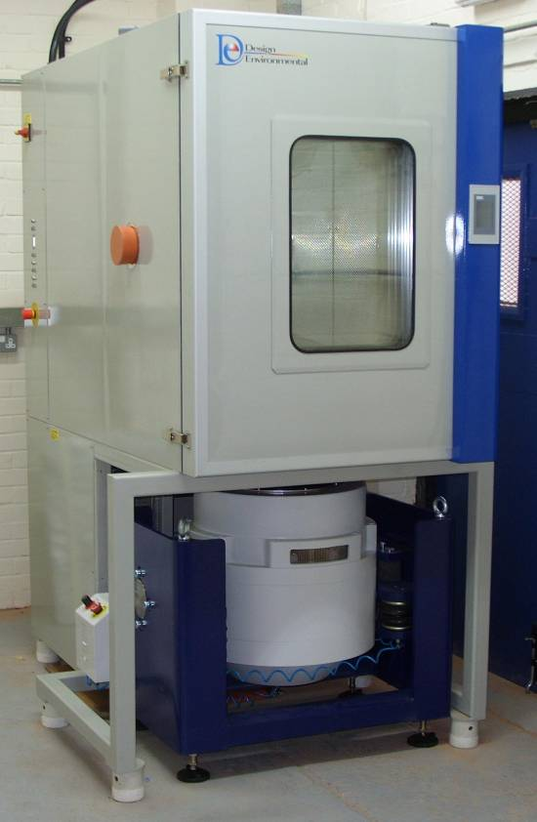
Environmental Testing
Conditions include:
Temperature
Humidity
Vibration
Model ref: FS1100-70V
Internal size: 1100mm wide x 1000mm high x 1000mm deep
Temperature range: -70°C to +180°C
Temperature rate of change: 10°C/min average heating and cooling to IEC600068
Humidity Range: 10-98%RH

Slide 26
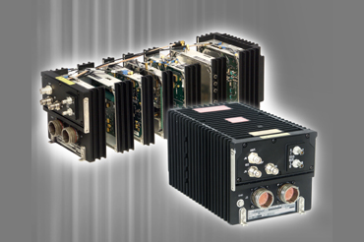
Environmental NFF - Example
Radio system failing whilst operating in hot climates
Failing randomly within operational tolerances
Inexplicably the radio will then recover, when tested their is no symptom of failure
Correlating the failure occurrences to the mission periods a potential cause has been identified as temperature.
Notes:
The Merlin helicopter radio has suffered in operation failures. Often the loss of the radios operation happens during long periods of a mission risking mission success and personal safety. Inexplicably the radio will then recover, when tested their is no symptom of failure – NFF.
Correlating the failure occurrences to the mission periods a potential cause has been identified as temperature.
The radio will be put under a variety of environmental tests within the TES Centres EC in an effort to confirm this. In addition the use of the Thermoscope will be used to identify abnormal hotspots – maybe identifying design flaws.
Questions to be answered:
Using the Studios Thermoscope to investigate heat propagation through the system
How do Thermoscope results compare to heat fluid models.
At what temperatures does failure occur and in what operational state (I.e. receiving/transmitting)
Are the temperature safety devices working

Slide 27

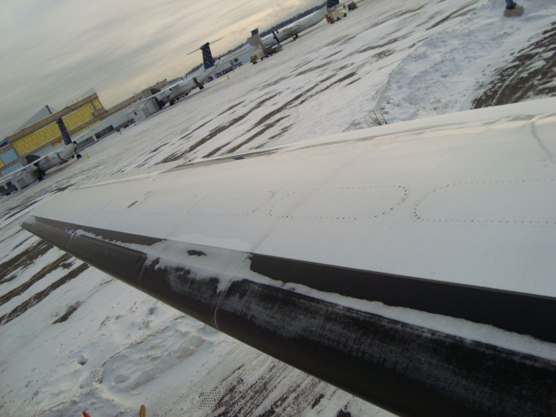
Environmental NFF - Example
De-icing system (DDV)
Turboprop aircraft
Failure during conditions which it is designed to operate
Testing reveals no faults
Difficult to reproduce operating conditions
Notes:
Several trips to Flybe in Exeter, providing us with facility tours, procedures and data.
Should be emphasised that Flybe are keen to support the project, and have offered us this case study to help us not to get some free labour
The turboprop fleet (Q400) has a de-icing system which operates on the concept of a membrane on the leading edge of the wing known as a boot. When the presence of ice is detected a pressure valve (Dual Distribution Valve) releases air and inflates the boot breaking the ice of the wing.
However, this has system has been failing in icey conditions. At first they suspected that the boot was allowing the ingress of water which was freezing the valve, and upon ground testing this ice had melted and hence NFF.
Even if this was the case there is a heating mechanism in the valve which should prevent freezing, a similar system on the outer edge of the engines however does not suffer NFF – part of the investigation is to look at is there a potential impact due to design here?
Another factor to consider is that the turboprop fleet in (Flybe) Finland operates in much colder conditions but has much less NFf than the UK fleet – it is suspected that relative humidity may be a factor here.
Flybe (Andy Johnson) has agreed to allow us to borrow a DDV in the warmer months (June) to put under test in the EC.

Slide 28
Overview
Basics of NFF
Cost Impact of NFF
Environmental Causes of NFF
Intermittent Faults
Intermittent Fault Testing

Slide 29
Intermittent Faults
One of the main root causes of NFF
Difficult to detect
Random in nature
Impossible to predict
Intermittents are not well understood – and hence often avoided
To understand and solve NFF we need to develop/establish the science behind the phenomena – including the physics of intermittents

Slide 30
Intermittent Faults
Intermittent faults are early symptoms of degradation of some physical property of a given component.
As the degradation of this physical property increases the size and regularity of the intermittent will also change.
Intermittent faults have dynamics
Severe degradation will result in permanent (hard) faults so intermittent dynamics must evolve towards a single hard fault as degradation increases

Slide 31
Intermittency vs Maintenance
Test Equipment optimised to hard faults, not intermittent
Maintenance Data & Knowledge optimised to hard faults, not intermittent
Intermittent Faults
‘Box Swapping’
Repeat Faults
Ops/Business pressure demands ‘quick fixes’

Slide 32
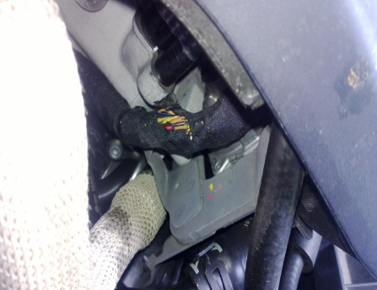
Intermittent Fault Causes
Cracked Solder
Thermal cycling fatigue
Broken wires

Slide 33
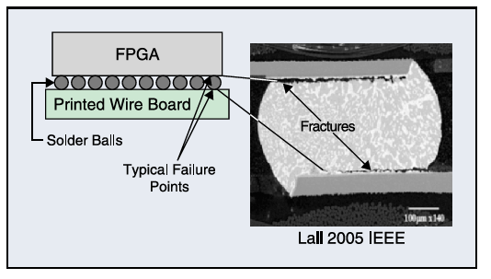
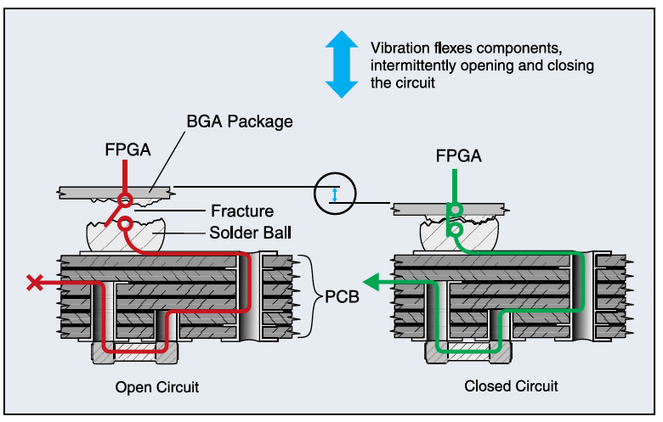
PCB Interconnect Fractures
Component PCB Interconnect failures have two main root causes
Rapid loading of the solder joint
A significant tensile component to the loading
Vibration will flex the components intermittently opening and closing the circuit
The effects of the intermittent signal can cause further damage to connected components

Slide 34
Fault Types – Basic Fundamentals
Hard Fault
Continuous
Output performance unacceptable (including complete loss of functionality)
Result of physical degradation
Maintenance action – physical repair, replace etc
Fault Amplitude
Hard Fault
Time
Transient Fault
Single event (unlikely to reoccur in the same form)
Temporary change in system output or tripped system
Result of unpredicted behaviour i.e. environmental fluctuation.
Maintenance Action – System test, system reboot
Fault Amplitude
Transient Fault
Time

Slide 35




Fault Types – Basic Fundamentals
$$f_{1}$$
$$f_{2}$$
$$f_{3}$$
$$f_{n}$$
Intermittent Fault
Discrete event (periodic switching between faulty and non faulty modes)
Temporary change in system output or tripped system
Result of early physical degradation
Maintenance Action – System monitoring, physical repair, replacement
Fault Amplitude
Recovery Period
Time

Slide 36


Intermittent Fault Dynamics
Fault time
Recovery time
Fault Duration
Recovery Period
Size of Fault
Fault Rate
Fault Duration
Fault rate (N° Faults within a time window T)
Fault
Recovery Period
Amplitude
$$t_{fault}$$
$$t_{reset}$$
Time
Notes:
There will be a pattern of intermittency between points in time A and B which will change over time - this is what we call the intermittent fault dynamics and will be discussed next.

Slide 37
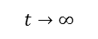
Intermittent Faults and Degradation
Total Destruction
100 %
Degree of Degradation (%)
Hard Fault Region
Intermittent Fault Region
Fault Free Region
Time
Intermittent Fault Amplitude
$$t→∞$$
Time
Time
Time
Time
Notes:
There will be a pattern of intermittency between points A and B which will change over time - this is what we call the intermittent fault dynamics and will be discussed next.

Slide 38
PCB Interconnect Fractures
Component PCB Interconnect failures have two main root causes
Rapid loading of the solder joint
A significant tensile component to the loading
Vibration will flex the components intermittently opening and closing the circuit
The effects of the intermittent signal can cause further damage to connected components

Slide 39
Overview
Basics of NFF
Cost Impact of NFF
Environmental Causes of NFF
Intermittent Faults
Intermittent Fault Testing

Slide 40
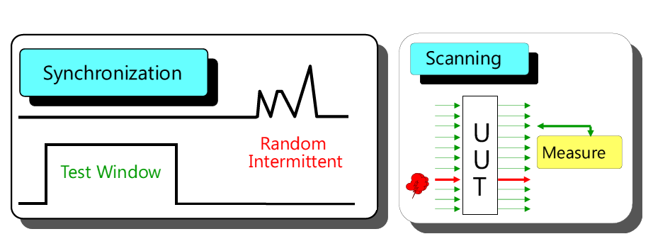
Intermittent Fault Detection

Slide 41
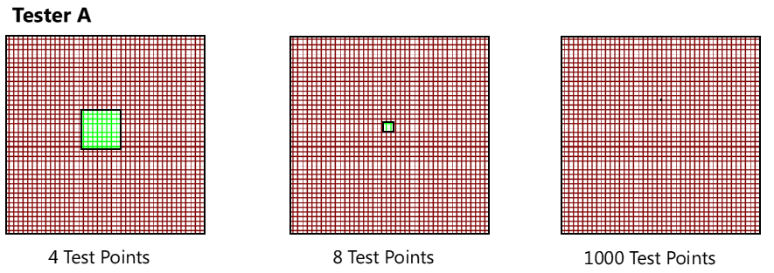
Intermittent Fault Detection - Scanning

Slide 42

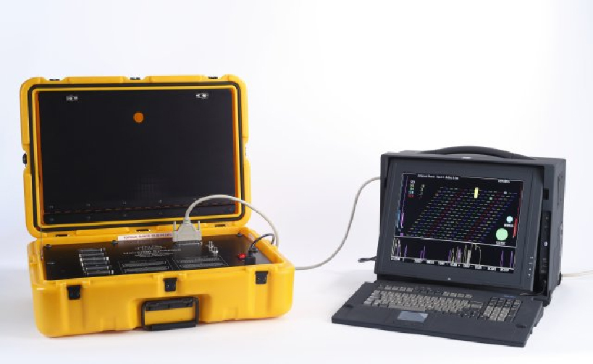
Intermittent Fault Detection - Testing
Testing all test points simultaneously

Slide 43
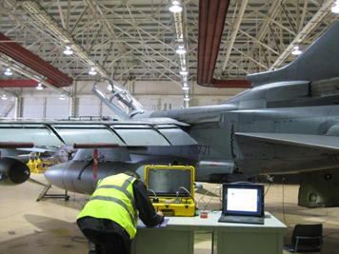
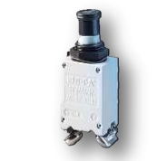
Example – Tornado Cross Clutch Drive
5-year Intermittent Fault
500 maintenance hours incurred
30 components changed on spec
CTL fault history review ruled out LRUs
3 days Ncompass™ testing ruled out EWIS
Led directly to root-cause identification:
Ncompass™ testing of CB immediately confirmed intermittency
Copyright – Copernicus Technology Ltd
http://www.copernicustechnology.com/index.php/success-stories/tornado-testing

Slide 44
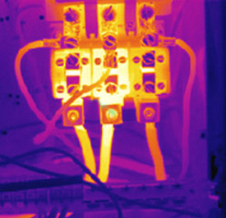
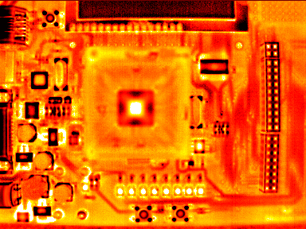
Thermography Inspections
Faulty connections and components in an energised circuit operating will begin to heat up before they fail
Components, such as resistors and capacitors the build-up of heat will be entirely normal, but for many components the build-up of heat – or even lack of heat will indicate a problem.

Slide 45

X-Ray Inspections
X-ray inspections can highlight shorts or coupling faults buried within the layers of multiplayer printed circuit boards non-invasively
Structural integrity assessed through 3D image reconstruction
Sophisticated features concerning the solder volume, fillet, voids and solder thickness can reliably be determined only by X-ray transmission.
Notes:
Advantage over optical systems xrays can see multplayer and below the surface

Slide 46
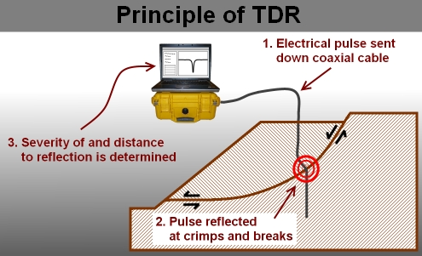
Reflectometry
The use of reflectometry is commonly used to determine the integrity of cables and wiring with effective localisation of intermittent faults such as open or short circuits.
These methods send a high frequency signal down the line, which reflects back at impedance discontinuities
The location of the fault is determined by the phase shift between the incident and reflected signals.

Slide 47
Summary
System Integrity Factors (Design/Use/Environment) are directly drivers towards No Fault Found (NFF)
Component degradation causes intermittency
Intermittency is a major cause of NFF events
Targeted use of Intermittent Fault Detection testing to rapidly find fault root causes in wiring, LRUs

Slide 48
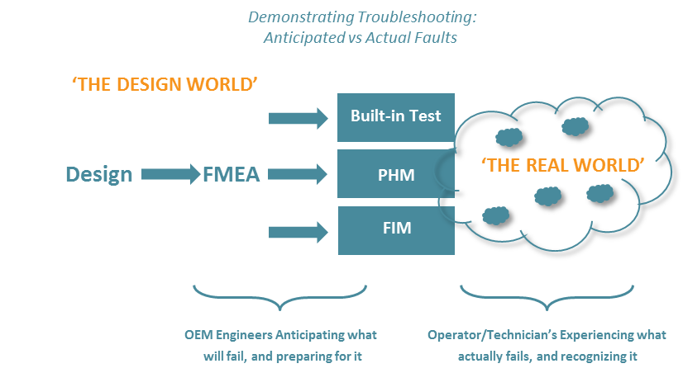
Reducing NFF through System Design
Notes:
Objectives of the research is to attempt to link the design world to the real world so that designers can better anticipate real-world events i.e. operating conditions, enviroments etc and the operator/technicians have the necessary information and capabilities to recognise failures when they happen.

Slide 49
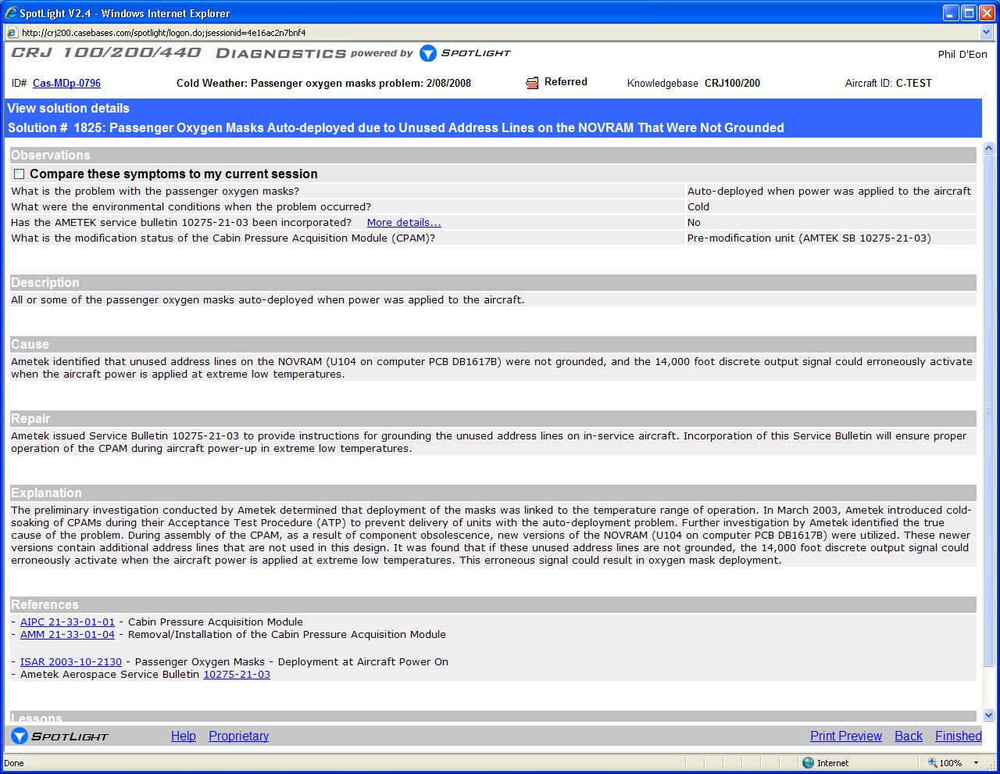
<Cold Weather deploys masks>
More Examples . . .
Sensitive to Extreme Cold Only When Installed
Notes:
This unit passes bench test. But it’s not a “rogue unit” because all units are susceptible to this behaviour. A chip change in the board design had added a number of extra address lines that were not grounded. In extremely cold weather, those lines could activate when power was applied, triggering deployment of the oxygen masks. The post-mod units were not susceptible to that failure mode.

